Slide 1
Heroes of Pymoli Summary
Homework #4
Nary Tang

Slide 2
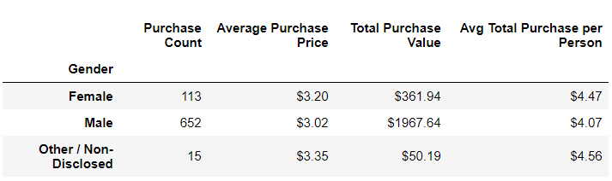
Observation #1: While women only represent 14% of total players, their average total purchase/person is 10% higher than male players

Slide 3
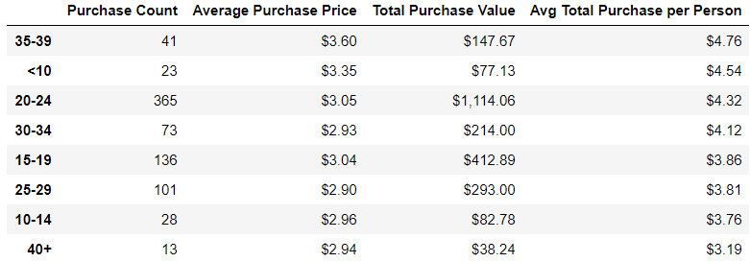
Observation #2: While the age group “35–39” only represent 5% of purchases, they have the highest average total purchase/person

Slide 4
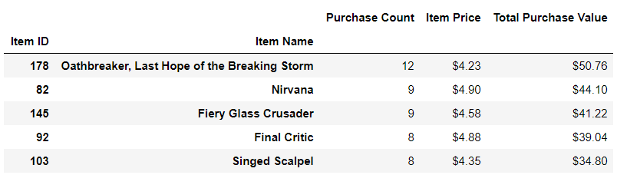
Observation #3: The most popular purchase item only represents ~1.5% of all purchases

Slide 5
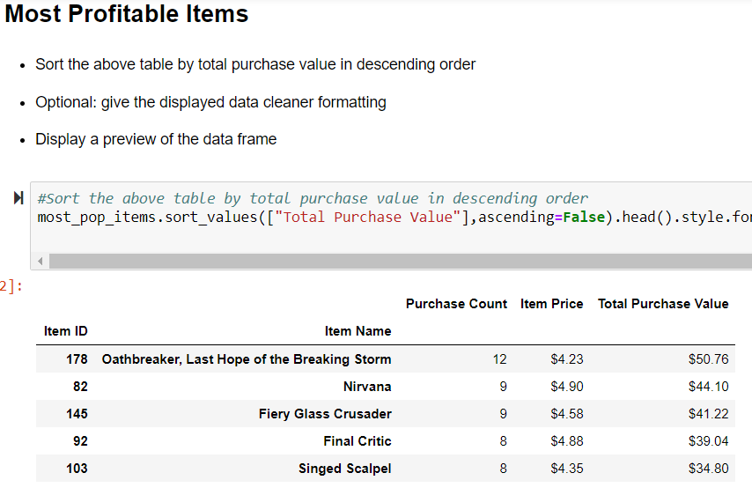
Observation #4: How can you determine profitability without cost???

Slide 6


Observation #5: You should probably close shop…j/k because once again…we don’t know your costs!

